Slide 1
Planarity and Kuratowski’s Theorem

Slide 2
Planar Graphs

Slide 3
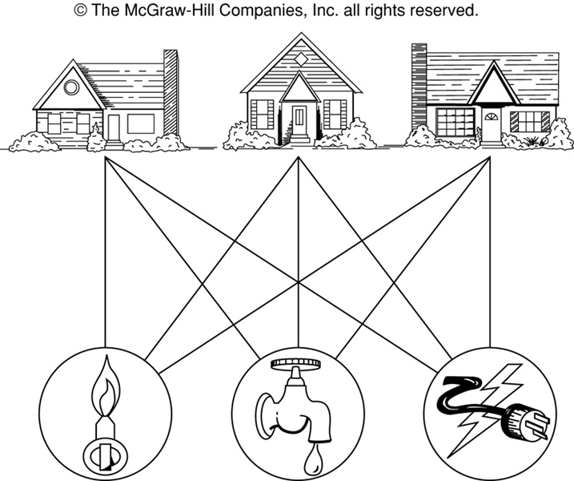
The House-and-Utilities Problem

Slide 4
Planar Graphs
Consider the previous slide. Is it possible to join the three houses to the three utilities in such a way that none of the connections cross?

Slide 7
Planar Graphs
Phrased another way, this question is equivalent to: Given the complete bipartite graph K_{3,3}, can K_{3,3} be drawn in the plane so that no two of its edges cross?
K_{3,3}

Slide 8
Planar Graphs
A graph is called planar if it can be drawn in the plane without any edges crossing.
A crossing of edges is the intersection of the lines or arcs representing them at a point other than their common endpoint.
Such a drawing is called a planar representation of the graph.

Slide 11
Example
A graph may be planar even if it is usually drawn with crossings, since it may be possible to draw it in another way without crossings.

Slide 12
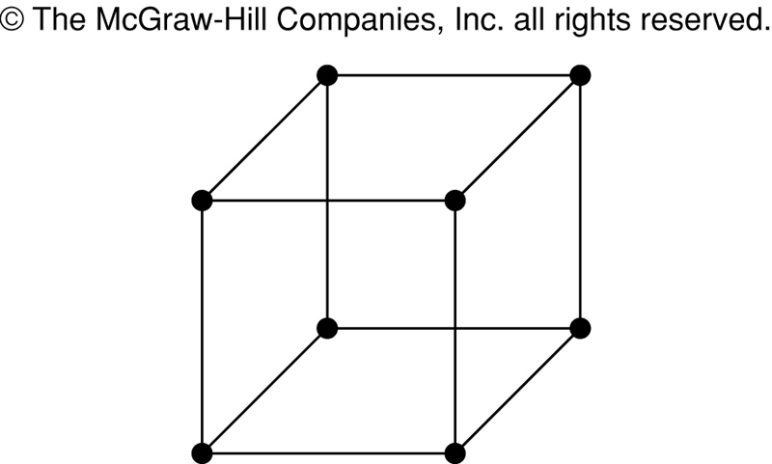
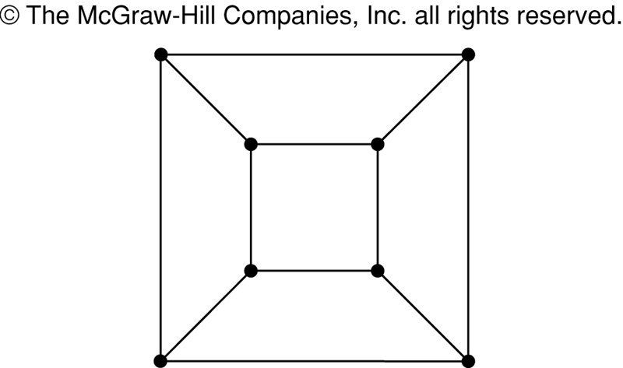
Example
A graph may be planar even if it represents a 3-dimensional object.

Slide 13
Planar Graphs
We can prove that a particular graph is planar by showing how it can be drawn without any crossings.
However, not all graphs are planar.
It may be difficult to show that a graph is nonplanar. We would have to show that there is no way to draw the graph without any edges crossing.

Slide 16
Regions
Euler showed that all planar representations of a graph split the plane into the same number of regions, including an unbounded region.
R₄ R₃ R₂
R₁

Slide 17
Regions
Each region has some degree associated with it given as-
Degree of Interior region = Number of edges enclosing that region
Degree of Exterior region = Number of edges exposed to that region
R₄ R₃ R₂
R₁

Slide 18
Regions

Slide 19
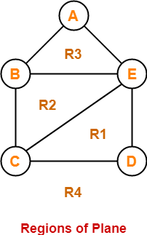
Example
Here, this planar graph splits the plane into 4 regions- R1, R2, R3 and R4 where-
Degree (R1) = 3
Degree (R2) = 3
Degree (R3) = 3
Degree (R4) = 5

Slide 20
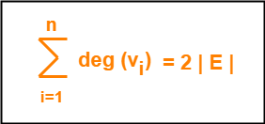
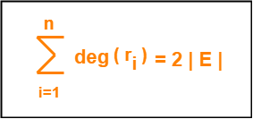
Planar Graph Properties-
Property-1 In any planar graph, Sum of degrees of all the vertices = 2 x Total number of edges in the graph
Property-2:
In any planar graph, Sum of degrees of all the regions = 2 x Total number of edges in the graph

Slide 23
Property 2-Special Cases
Case-01:
In any planar graph, if degree of each region is K, then-
K x |R| = 2 x |E|
Case-02:
In any planar graph, if degree of each region is at least K (>=K), then-
K x |R| <= 2 x |E|
Case-03
In any planar graph, if degree of each region is at most K (<=K), then-
K x |R| >= 2 x |E|
Property-2:
In any planar graph, Sum of degrees of all the regions = 2 x Total number of edges in the graph

Slide 24

Planar Graph Properties-
Property-3: If G is a connected planar simple graph with ‘e’ edges, ‘v’ vertices and ‘r’ number of regions in the planar representation of G, then-
This is known as Euler’s Formula.
It remains same in all the planar representations of the graph.

Slide 27
Problem 1
Let G be a connected planar simple graph with 25 vertices and 60 edges. Find the number of regions in G.
Ans: Total number of regions in G = 37

Slide 29
Problem 2
Let G be a connected planar simple graph with 20 vertices and degree of each vertex is 3. Find the number of regions in G
Total number of regions in G = 12.

Slide 30
Non-Planar Graphs

Slide 31
Non-Planar Graphs
Can we draw a map so that there are 5 countries
such that any two of which are adjacent?
NO

Slide 32
Regions
In any planar representation of K_{3,3}, vertex v₁ must be connected to both v₄ and v₅, and v₂ also must be connected to both v₄ and v₅.
v₁ v₂ v₃
v₄ v₅ v₆

Slide 33
Regions
The four edges {v₁, v₄}, {v₄, v₂}, {v₂, v₅}, {v₅, v₁} form a closed curve that splits the plane into two regions, R₁ and R₂.
v₁ v₅
R₂ R₁
v₄ v₂

Slide 34
Regions
Next, we note that v₃ must be in either R₁ or R₂.
Assume v₃ is in R₂. Then the edges {v₃, v₄} and {v₄, v₅} separate R₂ into two subregions, R₂₁ and R₂₂.
v₁ v₅ v₁ v₅
R₂₁
R₂ R₁ → v₃
R₂₂
v₄ v₂ v₄ v₂

Slide 35
Regions
Now there is no way to place vertex v₆ without forcing a crossing:
If v₆ is in R₁ then {v₆, v₃} must cross an edge
If v₆ is in R₂₁ then {v₆, v₂} must cross an edge
If v₆ is in R₂₂ then {v₆, v₁} must cross an edge
v₁ v₅
R₂₁
v₃ R₁
R₂₂
v₄ v₂

Slide 36
Regions
Alternatively, assume v₃ is in R₁. Then the edges {v₃, v₄} and {v₄, v₅} separate R₁ into two subregions, R₁₁ and R₁₂.
v₁ v₅
R₁₁
R₂ R₁₂ v₃
v₄ v₂

Slide 37
Regions
Now there is no way to place vertex v₆ without forcing a crossing:
If v₆ is in R₂ then {v₆, v₃} must cross an edge
If v₆ is in R₁₁ then {v₆, v₂} must cross an edge
If v₆ is in R₁₂ then {v₆, v₁} must cross an edge
v₁ v₅
R₁₁
R₂ R₁₂ v₃
v₄ v₂

Slide 38
Planar Graphs
Consequently, the graph K_{3,3} must be nonplanar.
K_{3,3}

Slide 39
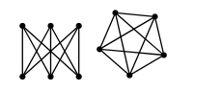
observation
Here are two graphs I promise aren't planar: K3,3 and K5.

Slide 40
Testing for Planarity
Planarity algorithm
Kuratowski’s Theorem

Slide 41
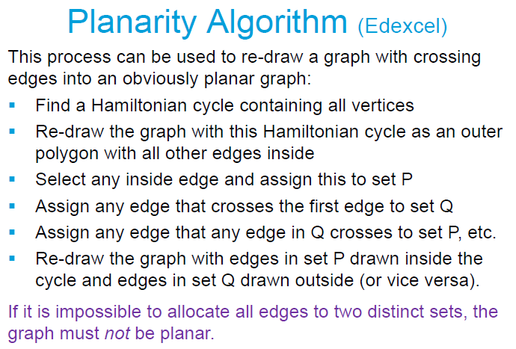
Testing for Planarity

Slide 42
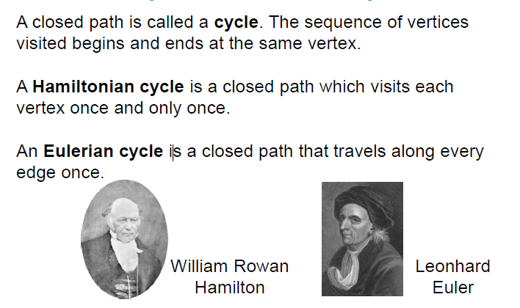
Hamiltonian cycle

Slide 44
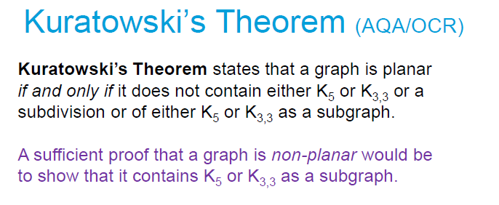
Testing for Planarity

